Slide 1

Welcome to FARMSUITE A Project By SharkTech
SDA Project Group Members:
Salar (i200830), Nouman Hafeez, and Sarim.

Slide 2
About FARMSUITE
Across Pakistan, from Sindh to Kashmir, many dairy farms operate with unique regional features. Despite these differences, the essential procedures of dairy farming are remarkably similar. Managing livestock requires urgency, organization, and accurate areas where our application aims to help. Our application streamlines farm processes and facilitates direct communication between farmers, owners, and shopkeepers. It helps farm owners understand their operations better, allowing them to analyze costs, resources, and responsibilities. This enables them to achieve their goals more effectively and maximize their farm's potential.
Our application, FarmSuite, will be focused on all the dairy farms scattered all around Pakistan. Our application would not be focused on connecting these farms together, but in fact improving the managerial ability of each individual farm. While some applications related to farming do exist, none exist that are centered around dairy farms.

Slide 3
Objectives
1. An efficient system for scheduling and managing tasks around a dairy farm.
2. An interface to sell produce at a local shop.
3. An interface to communicate with vets, owners, fodder providers.
4. A record system to show sales reports.
5. A record system to show production reports.
6. Improve time and resource management and reduce labor costs.

Slide 4
Use Cases
By Salar Shoaib (20I-0830):
1. Assign tasks
2. Update Milk production per cow
3. Perform sales
4. Get a report on cow performances
5. Get a report on sale performances
By Sarim Rasheed (22I-1280):
6. Built in Calculator to calculate order bill (this is an include use case, so it will be system
sub goal in the level field) - by
7. Update tasks and statuses
8. Report issues to owner
9. Send a message to Vet
10. Order and manage fodder
By Nouman Hafeez (21I-0416)
11. Waste disposal contact with nursery
12. Monitor Farm Activity via Live Camera Feed - FarmCam
13. Schedule Veterinary Visits
14. Track Livestock Health Records
15. Manage Farm Expenses
16. Credit card verification

Slide 5
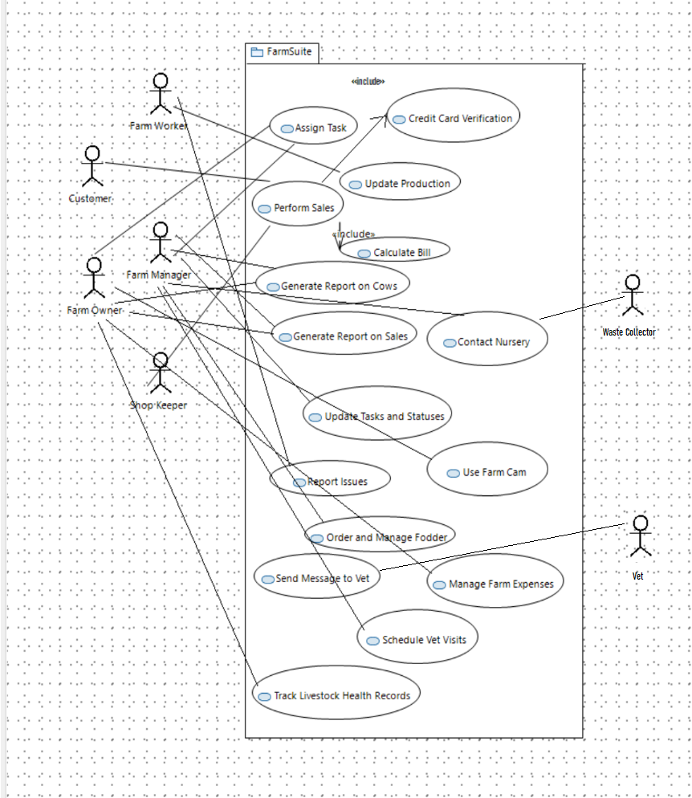
Use Case Diagram

Slide 6
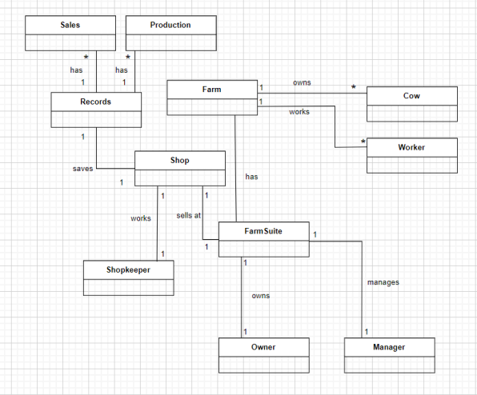
Domain Diagram

Slide 7
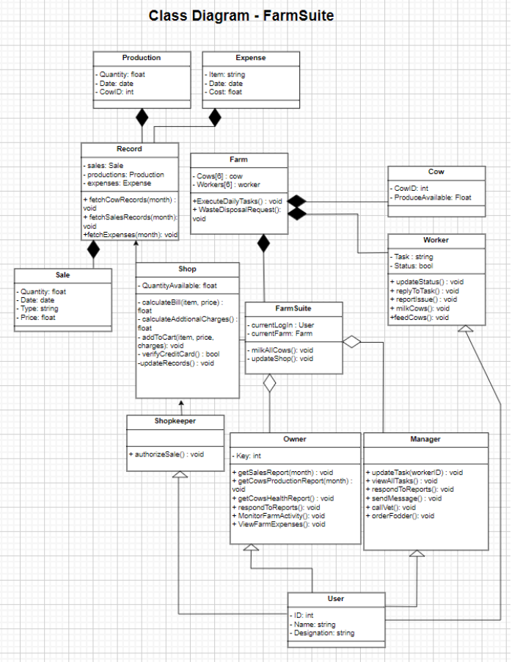
Class Diagram

Slide 8
Package Diagram

Slide 9
Component Diagram

Slide 10
Deployment Diagram

Slide 11
Design Patterns Used
Few Controllers Deployed to avoid the issue of bloated controller.
Information Expert used for the extration of all reports and information.
Creator used for the creation of objects as needed.
Low Coupling and High Cohesion used as much as possible.
Different type of Users, hence Polymorphism used.
Singleton used for the Farm, as there is one Farm, and for there being only one Database connection.
Façade used to tie different uilayers together.
Strategy Pattern Deployed for Generating Reports. Based on User LogIn, different reports are generated using the same design.
Oberserver Pattern is used for updating Fodder.

Slide 12
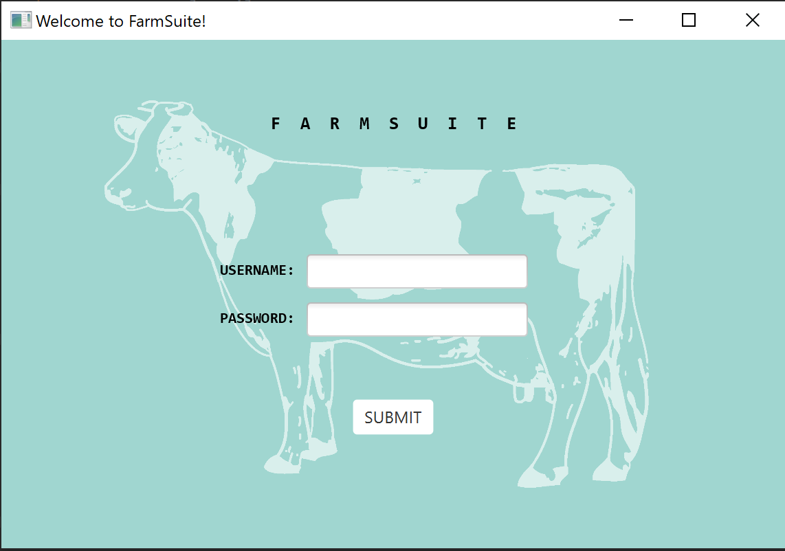
Main Functionalities

Slide 13
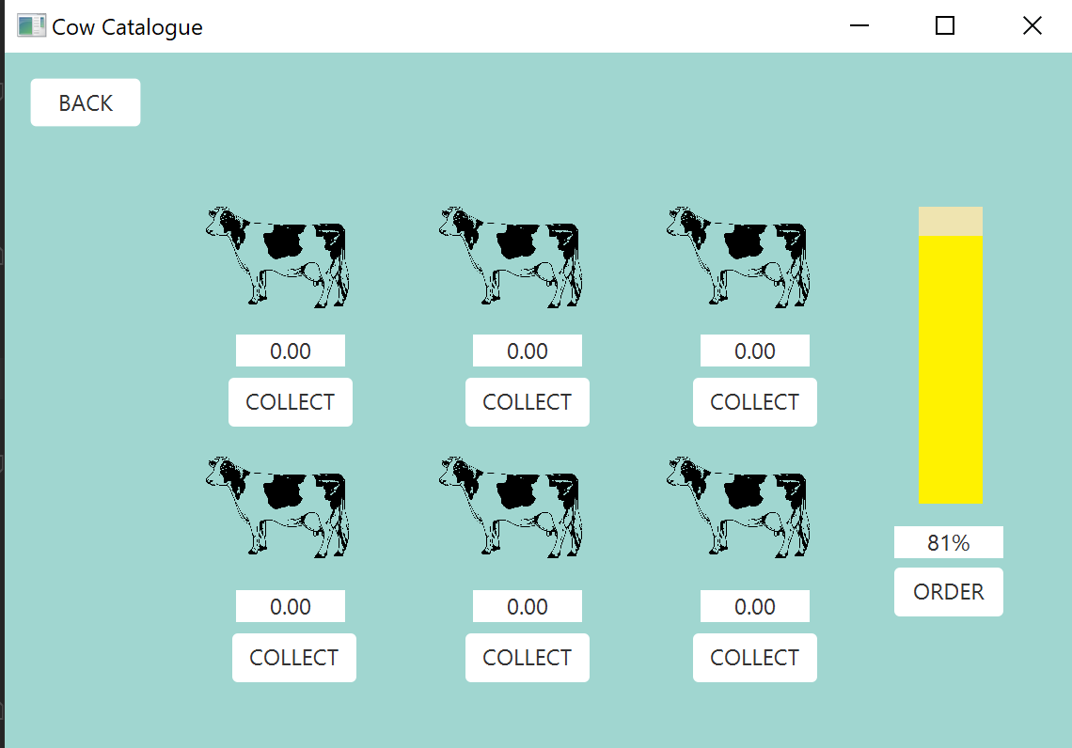
Main Functionalities

Slide 14
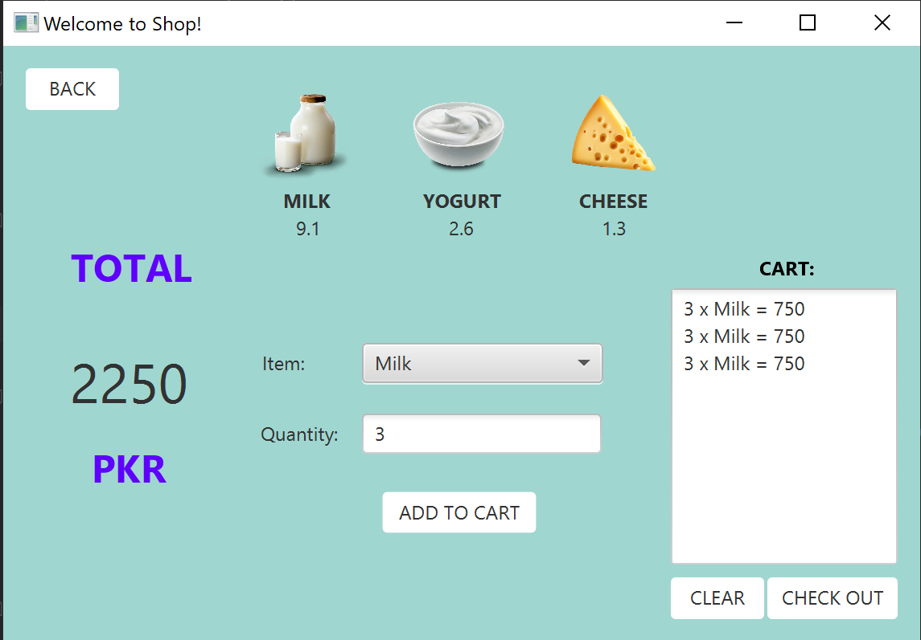
Main Functionalities

Slide 15
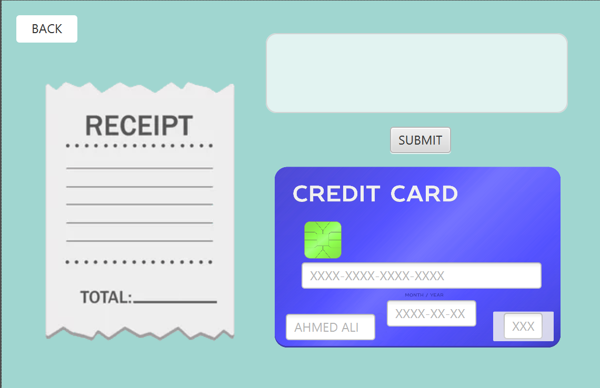
Main Functionalities

Slide 16
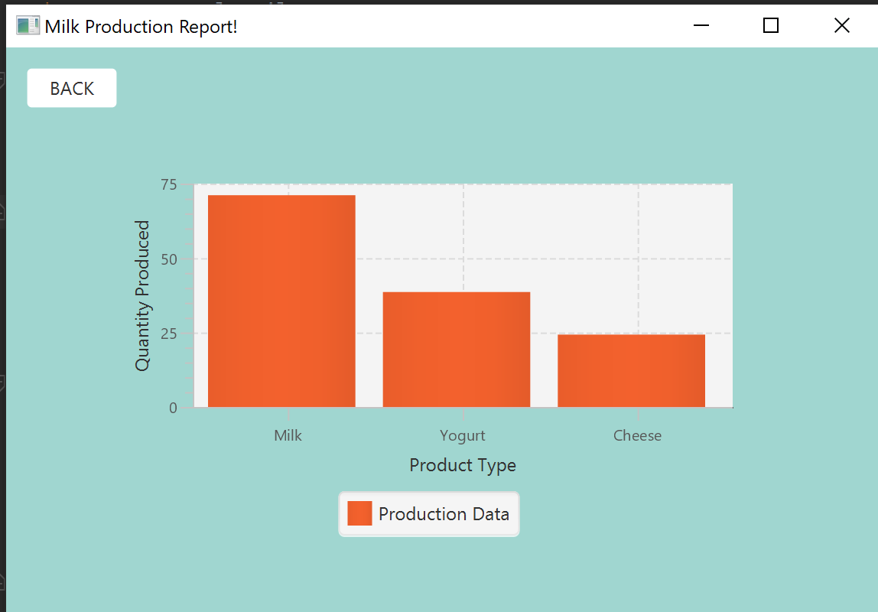
Main Functionalities

Slide 17
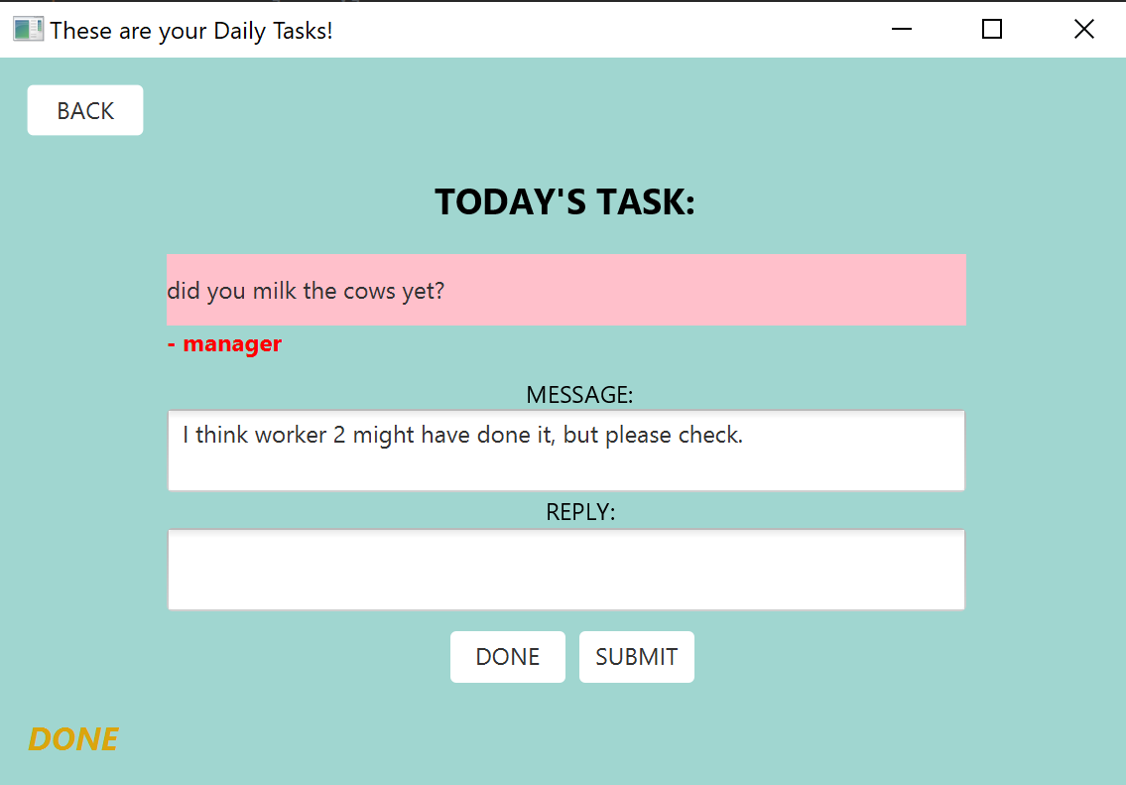
Main Functionalities

